Slide 1
Building Reliable Infrastructure for Distributed Big Data Analytics: Automating Network Configuration Management Using Formal Methods
Qiao Xiang
Collaborators: Jiwu Shu, Lizhao You, Rulan Yang, Xing Fang,
Zhihao Zhang, Ridi Wen, Chenyang Huang,
Yuxin Wang, Xiwen Fan, Hanyang Shao
12/9/2022

Slide 2
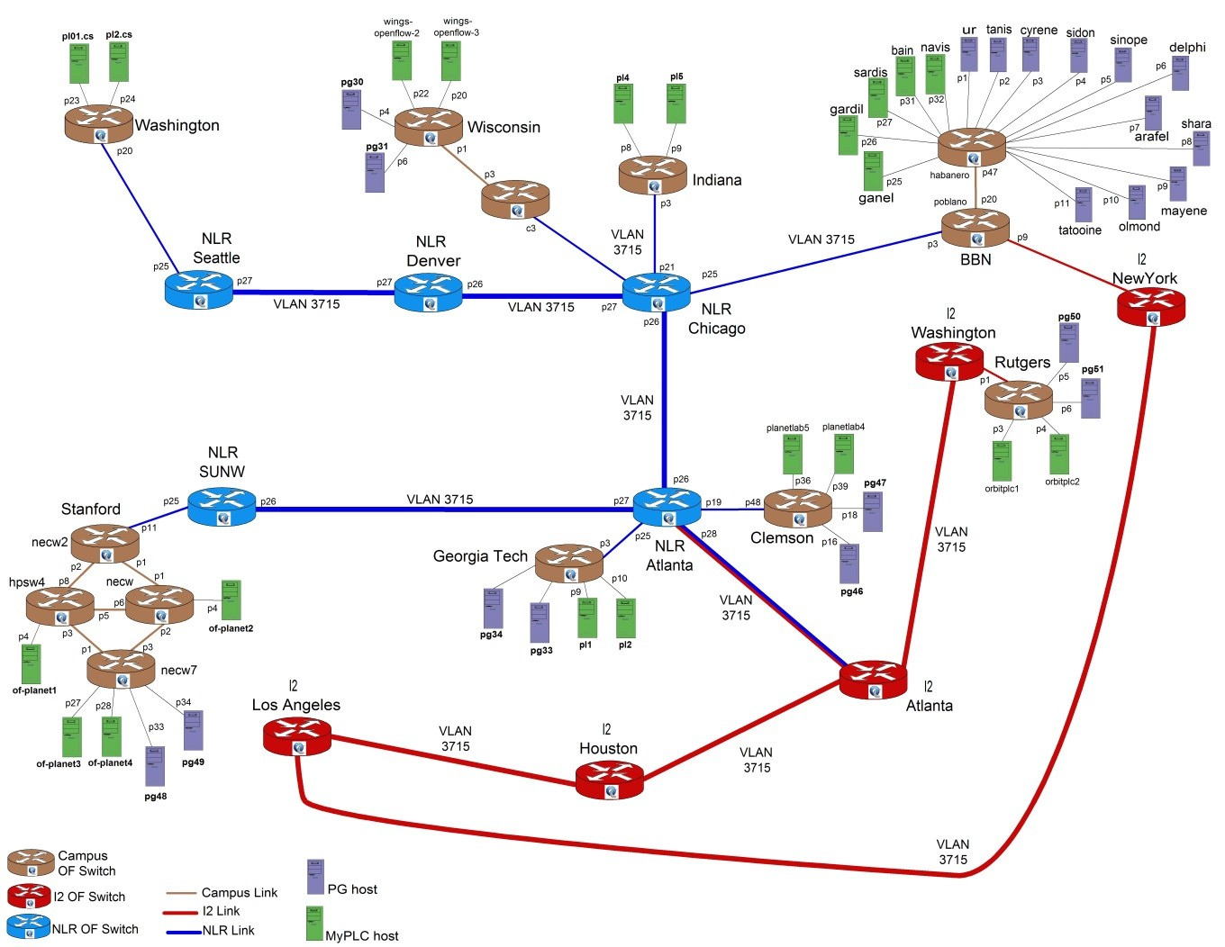

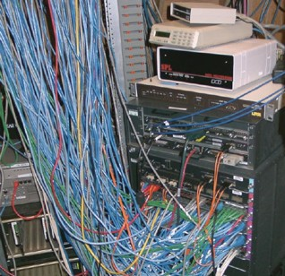
Background
Distributed big data analytics require reliable networks
Networks are becoming larger and complex
Heterogeneous devices
Frequent outages lead to cost
Source: http://groups.geni.net/geni/chrome/site/thumbnails/wiki/TangoGENI/OF-VLAN3715_1000.jpg

Slide 3
Data Forwarding Correctness
Reachability: Two hosts can communicate with each other while complying security policies
Example 1：There are no forwarding loops or black holes in forwarding paths between devices.
Example 2：Isolation among different tenants in datacenters.
Waypointing: The traffic should traverse a chain of devices m₁, . . . ,m_{k}
Path consistency: The reachability of the same traffic should always be satisfied when it enters the same network from different border devices.
Network verification:
Examine whether the forwarding behaviors of the network satisfied
pre-defined requirements.

Slide 4
Network verification: current progress
Control plane/Configuration
Data plane
Configuration
FIB
(RIB/ACL…)
Execute
Configuration
FIB
(RIB/ACL…)
What Happens After Verification?
FIB
(RIB/ACL…)
Configuration
Control plane/Configuration verification
Batfish [NSDI'15]
Bagpipe [OOPSLA'16]
Minesweeper [SIGCOMM'17]
Bonsai [SIGCOMM'18]
Hoyan [SIGCOMM'21]
SRE [SIGCOMM'22]…
Data plane verification
HSA [NSDI'12]
Veriflow [NSDI'13]
Atomic Predicates [ICNP'13]
APKeep [NSDI'20]
Flash [SIGCOMM'22]
Coral [HotNets'22]…
Notes:
Traditional operators don’t use verification
That may be changing with new tools like HSA, Veriflow
Still, there is simulation in the mix, because the control plane will be simulated

Slide 5
Toward automatic network configuration management
Distributed data
plane verification:
Data plane verification problem can be decomposed into multiple lightweight tasks executed at devices, enabling scalable distributed verification in large networks
Control plane verification
A-Graph [INFOCOM'21]
CCoral [WIP]
Network
Verification
Data plane verification
Coral [HotNets'22]
Flash [SIGCOMM'22]
Configuration Repair
Error Diagnosis
Paper/source code：
arxiv.org/abs/2205.07808
github.com/sonic-net/SONiC/pull/948
Interactive demo： distributeddpchecking.com:8443,
IEEE/ACM SC'22
Configuration diagnosis and repair
Scalpel [WIP]

Slide 6
Configuration diagnosis and repair: Related works
Data provenance-based diagnosis tools
Examples: ExSPAN [SIGMOD'10], Y! [SIGCOMM'14], DiffProv [SIGCOMM'16]
Approach: Maintain network logs and do offline analysis based on Datalog
Limitations：Need to reimplement network protocols, Lack of the control flow analysis of the network execution
SMT-based network model diagnosis tools
Examples: CEL [arXiv'22]
Approach: Compute minimal correction sets (MCSes) as the root cause of errors based on the network model of Minesweeper.
Limitations: Lacking of the interpretation makes it hard to understand

Slide 7
Configuration diagnosis and repair: Related works
Data provenance-based repair tools
Examples: MetaProvenance [NSDI'17]
Approach: Centralized offline repair based on Datalog
Limitations: Need to reimplement network protocols on SDN, Lack of the control flow analysis of the network execution
Abstract graph-based repair tools
Examples: CPR [SOSP'17]
Approach: Casts configuration repair as a MaxSMT problem whose constraints are based on a digraph-based representation of a control plane’s semantics
Limitations: The abstract graph can not express some flexible configurations such as BGP routing policies

Slide 8
Automatic configuration diagnosis and repair: key insight
Distributed route computations-> Centralized execution sequence:
Capturing the causal relationship among the distributed route computations of routers
Transfering these computations into one single, linear execution trace, enabling efficient configuration error diagnosis and repair

Slide 9
Distributed route computations-> Centralized execution sequence
A
The eBGP routing process on each router can be abstracted as:
dev: device ID
event: receive/send (BGP UPDATE message)
state: RIB-In, loc-RIB, RIB-Out
action: consequence new events after device update their state (e.g., BGP UPDATE message to neighbors)
S
eBGP
eBGP
D
action=dev(event, state)
eBGP
eBGP
B
P

Slide 10
Distributed route computations-> Centralized execution sequence
action=dev(event, state)
Distributed route computations：
(loc-RIB=[D], {[D]->A, [D]->B})
=D(origin, loc-RIB=[D])
(loc-RIB=[A, D], {[A, D]->S})
=A([D]->A, loc-RIB=[])
(loc-RIB=[S, A, D], {})
= S([A, D]->S, loc-RIB=[])
(loc-RIB=[B, D], {[B, D]->S})
=B([D]->B, loc-RIB=[])
(loc-RIB=[S, A, D], {})
= S([B, D]->S, loc-RIB=[S, A, D])
There exist such causal relationships among the distributed execution of routers:
External event (e.g., route announcement) triggers the next route computation.
The next route computation is based on the last internal state (e.g., loc-RIB)
[A, D]
A
[S, A, D]
[D]
[D]
S
D
B
[B, D]
P
Suppose：
S prefers A
S is forbidden to announce
A, B will not announce any route to D

Slide 11
Distributed route computations-> Centralized execution sequence
A
S
D
B
P
D(origin, loc-RIB=[D])
(loc-RIB=[D], {[D]->A, [D]->B})
=D(origin, loc-RIB=[D])
(loc-RIB=[A, D], {[A, D]->S})
=A([D]->A, loc-RIB=[])
(loc-RIB=[S, A, D], {})
= S([A, D]->S, loc-RIB=[])
(loc-RIB=[B, D], {[B, D]->S})
=B([D]->B, loc-RIB=[])
(loc-RIB=[S, A, D], {})
= S([B, D]->S, loc-RIB=[S, A, D])
A([D]->A, loc-RIB=[])
B([D]->B, loc-RIB=[])
S([A, D]->S, loc-RIB=[])
S([B, D]->S, loc-RIB=[S, A, D])
Causal relationship graph
(CRG)

Slide 12
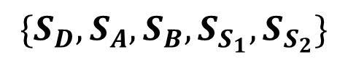
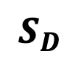
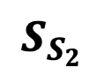
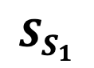
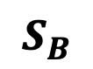
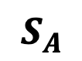
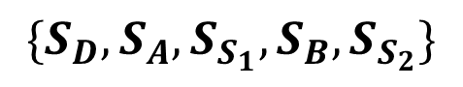
Distributed route computations-> Centralized execution sequence
A
S
D
B
P
Equivalence theorem: Given a network and its configuration C, we define the route computation result generated from C as S. Any topological traversal along the CRG is a sequence whose execution can result in S
Sequence 1：
Sequence 2：
They are equivalent
Input: CRG → Output: Linear execution sequence
D(origin, loc-RIB=[D])
$$S_{D}$$
$$S_{A}$$
$$S_{B}$$
Diagnosis of distributed router configuration transformed to trace-based centralized program diagnosis
A([D]->A, loc-RIB=[])
B([D]->B, loc-RIB=[])
$$S_{S_{1}}$$
$$\{S_{D}, S_{A}, S_{S_{1}}, {S_{B},S}_{S_{2}}\}$$
S([A, D]->S, loc-RIB=[])
$$S_{S_{2}}$$
（a well-studied problem in the area of program analysis ）
$$\{S_{D}, S_{A}, S_{B}, S_{S_{1}}, S_{S_{2}}\}$$
S([B, D]->S, loc-RIB=[S, A, D])
CRG

Slide 13
Automatic configuration diagnosis and repair: challenges
Challenge 1: How to capture causal relationships？
Network protocols run in a distributed manner and do not provide such interfaces
Challenge 2: How efficiently analyze and localize the error？
Traditional trace analysis is flow-insensitive and imprecise
Challenge 3: How to compute the minimal repair？
Resynthesize a new configuration is impractical

Slide 14
Automatic configuration diagnosis and repair: Scalpel
Challenge1:
Capture the CRG
Challenge2:
Configuration error localization
Challenge3:
Configuration repair
execution trace
repair
errors
Lightweight capturing mechanism for device/simulation platform
Complete and sound error localization and explanation algorithm
configuration repairer using constraint solver

Slide 15
Capture the CRG: approach
A
S
D
B
P
Devices process events in a first-in-first-serve order and record route computation tuples (event, state, action) in order
Construct the CRG for each prefix based on event-action joins.
(loc-RIB=[D], {[D]->A, [D]->B})
=D(origin, loc-RIB=[D])
(loc-RIB=[A, D],
{[A, D]->S})
=A([D]->A, loc-RIB=[])
(loc-RIB=[B, D],
{[B, D]->S})
=B([D]->B, loc-RIB=[])
(loc-RIB=[S, A, D], {})
=S([A, D]->S,
loc-RIB=[])
(loc-RIB=[S, A, D], {}) =S([B, D]->S,
loc-RIB=[S, A, D])

Slide 16
Capture the CRG: implementation
Network device: Monitoring event queue, record snapshots in order (e.g., LSDB, RIB-In, Loc-RIB, RIB-Out)
Open source network software: Modifying source code to record
FRR, OpenR, SONiC…
Simulation platform: Modifying simulation process code to record
Batfish…

Slide 17
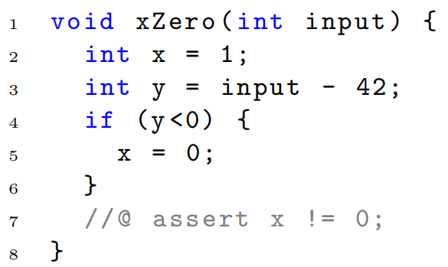
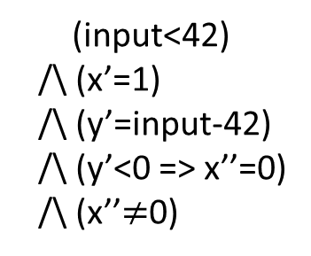
Configuration error localization: approach
Translate the execution sequence into trace formula
pre-condition/\trace/\post-condition
Minimal unsatisfiable core (MUC) as the minimal error statement set.
MUC: Any proper subset of the MUC is satisfiable
Error invariant (EI) for MUC as the explanation
EI: Indicate the intermediate state of execution
pre-condition
(input<42)
/\ (x’=1)
/\ (y’=input-42)
/\ (y’<0 => x’’=0)
/\ (x’’$≠$0)
input < 42
execution sequence
y' < 0
x'' = 0
post-condition
（requirements）
MUC
EI
Error explanation: The input<42 makes y’<0, then leading to x’’=0, which violates the requirement.

Slide 18
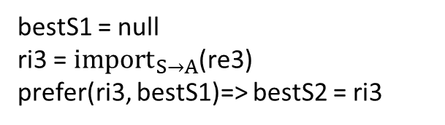
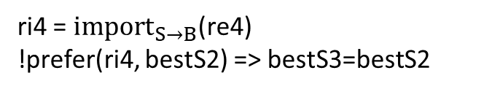
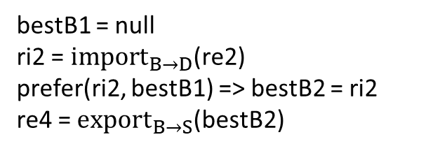
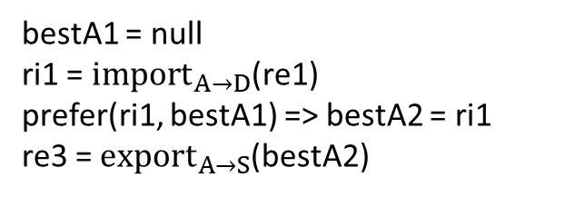
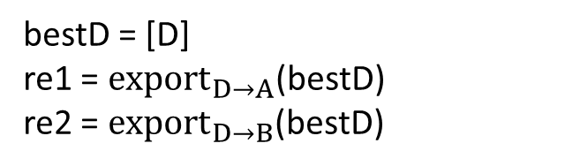
Configuration error localization: example
A
S
D
B
P
SMT Trace formula
bestD = [D]
re1 = ${export}_{D→A}$(bestD)
re2 = ${export}_{D→B}$(bestD)
bestS1 = null
ri3 = ${import}_{S→A}$(re3)
prefer(ri3, bestS1)=> bestS2 = ri3
(loc-RIB=[D], {[D]->A, [D]->B})
=D(origin, loc-RIB=[D])
Computation trace
bestA1 = null
ri1 = ${import}_{A→D}$(re1)
prefer(ri1, bestA1) => bestA2 = ri1
re3 = ${export}_{A→S}$(bestA2)
ri4 = ${import}_{S→B}$(re4)
!prefer(ri4, bestS2) => bestS3=bestS2
(loc-RIB=[A, D],
{[A, D]->S})
=A([D]->A, loc-RIB=[])
(loc-RIB=[B, D],
{[B, D]->S})
=B([D]->B, loc-RIB=[])
assert (bestS3.nexthop==B /\ bestB2.nexthop==D)
(loc-RIB=[S, A, D], {})
=S([A, D]->S,
loc-RIB=[])
(loc-RIB=[S, A, D], {}) =S([B, D]->S,
loc-RIB=[S, A, D])
bestB1 = null
ri2 = ${import}_{B→D}$(re2)
prefer(ri2, bestB1) => bestB2 = ri2
re4 = ${export}_{B→S}$(bestB2)
Postcondition (specification)

Slide 19
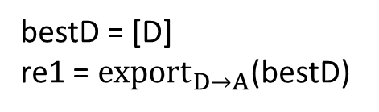
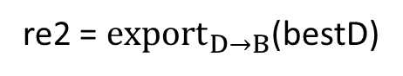
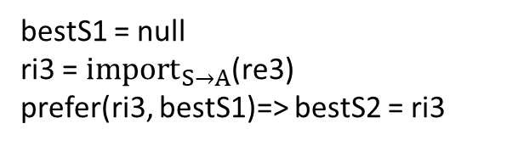
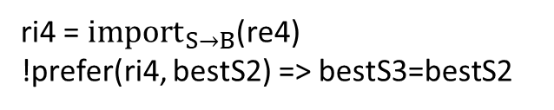
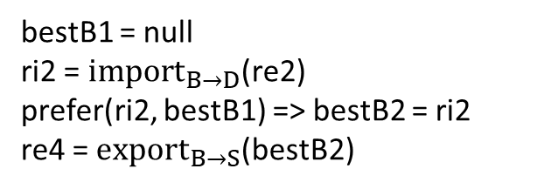
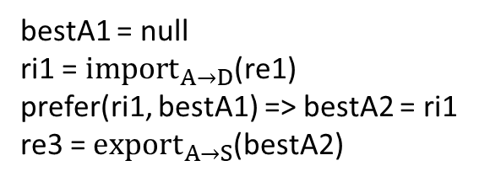
Configuration error localization: example
A
(loc-RIB=[D], {[D]->A, [D]->B})
=D(origin, loc-RIB=[D])
S
D
B
P
Localize error statements using MUC
(loc-RIB=[A, D],
{[A, D]->S})
=A([D]->A, loc-RIB=[])
bestD = [D]
re1 = ${export}_{D→A}$(bestD)
bestS1 = null
ri3 = ${import}_{S→A}$(re3)
prefer(ri3, bestS1)=> bestS2 = ri3
(loc-RIB=[B, D],
{[B, D]->S})
=B([D]->B, loc-RIB=[])
re2 = ${export}_{D→B}$(bestD)
bestA1 = null
ri1 = ${import}_{A→D}$(re1)
prefer(ri1, bestA1) => bestA2 = ri1
re3 = ${export}_{A→S}$(bestA2)
ri4 = ${import}_{S→B}$(re4)
!prefer(ri4, bestS2) => bestS3=bestS2
(loc-RIB=[S, A, D], {})
=S([A, D]->S,
loc-RIB=[])
assert (bestS3.nexthop==B /\ bestB2.nexthop==D)
(loc-RIB=[S, A, D], {}) =S([B, D]->S,
loc-RIB=[S, A, D])
bestB1 = null
ri2 = ${import}_{B→D}$(re2)
prefer(ri2, bestB1) => bestB2 = ri2
re4 = ${export}_{B→S}$(bestB2)

Slide 20
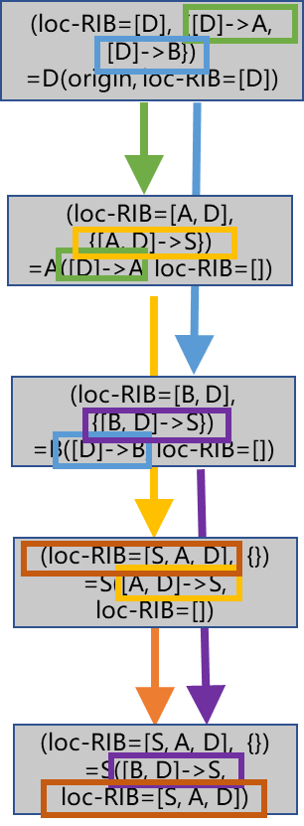
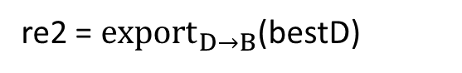
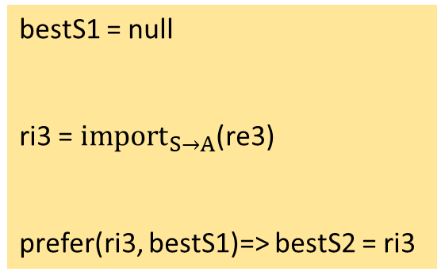
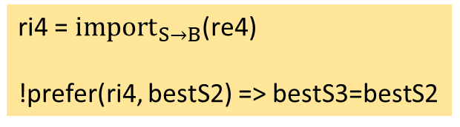
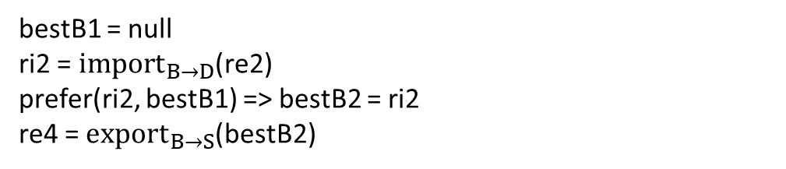
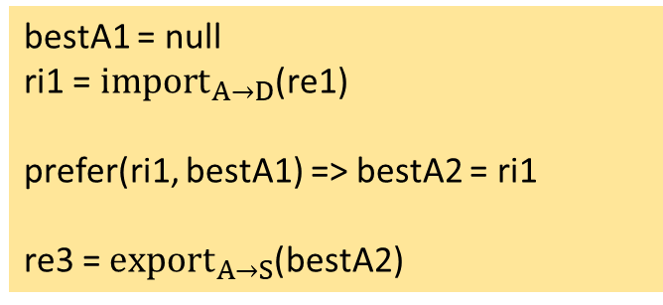
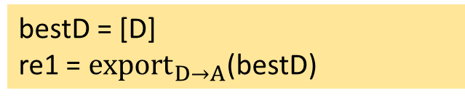
Configuration error localization: example
A
S
D
B
P
Compute error invariants (error explanation)
S receives route ri3 from A and selects ri3 as best route
bestD = [D]
re1 = ${export}_{D→A}$(bestD)
bestD.valid=true
ri1.valid=true
bestS1 = null
ri3 = ${import}_{S→A}$(re3)
prefer(ri3, bestS1)=> bestS2 = ri3
re2 = ${export}_{D→B}$(bestD)
bestS1.valid=False /\re3.valid=true /\ re3.nexthop=A
D sends re1 to A to (announce the route to prefix p)
bestA1 = null
ri1 = ${import}_{A→D}$(re1)
prefer(ri1, bestA1) => bestA2 = ri1
re3 = ${export}_{A→S}$(bestA2)
S receives route ri4 from B and sets its local-pref to 120, while the last best route at S is bestS2 whose local-pref is 200, as a result, S still choose bestS2 as the best route
bestA1.valid=false
bestS1.valid=False /\ ri3.valid=True /\ ri3.nexthop=A /\ ri3.localpref=200
ri.valid=true /\ bestA1.valid=false
bestA2.valid=true
bestS2. localpref=200 /\ bestS2.nexthop=A /\ re4.nexthop=B /\ re4.valid=true
re3.nexthop=A /\ re3.valid=true
ri4 = ${import}_{S→B}$(re4)
!prefer(ri4, bestS2) => bestS3=bestS2
bestS2. localpref=200 /\ ri4. localpref=120 /\ bestS2.nexthop=A
A receives route ri1 from D and selects it as best route, then Anounces re3 to S
bestB1 = null
ri2 = ${import}_{B→D}$(re2)
prefer(ri2, bestB1) => bestB2 = ri2
re4 = ${export}_{B→S}$(bestB2)
bestS3.nexthop = A
assert (bestS3.nexthop==B /\ bestB2.nexthop==D)

Slide 21
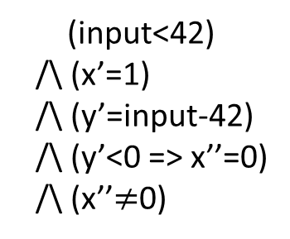
Configuration error localization: properties
Soundness: The statements sliced by EI are always unsatisfiable
Minimality: The explanation generated by MUC is the minimal explanation for the error.
(input<42)
/\ (x’=1)
/\ (y’=input-42)
/\ (y’<0 => x’’=0)
/\ (x’’$≠$0)
input < 42
y' < 0
x'' = 0
MUC
Sound
Minimal
EI

Slide 22
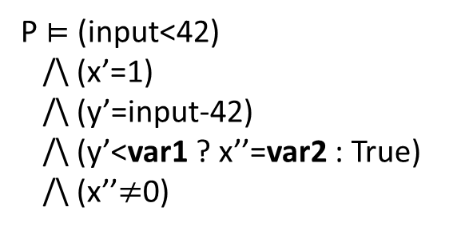
Configuration repair: approach
Mapping error statements to related configurations
Error statement: assignment/condition
Identify configurable
Set related configuration values symbolic
Re-encode the execution into SMT formula and solve the assignment for symbolic vars as repair
y < 0
y < var1
x = var2
x = 1
P $⊨$ (input<42)
/\ (x’=1)
/\ (y’=input-42)
/\ (y’<var1 ? x’’=var2 : True)
/\ (x’’$≠$0)
var1=0
var2=1

Slide 23

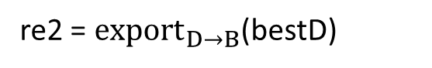
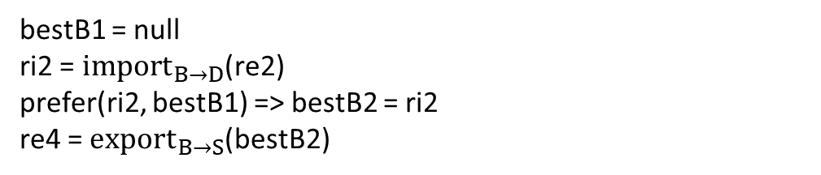

Configuration repair: example
bestD = [D]
re1 = ${export}_{D→A}$(bestD)
bestD.valid=true
route-map S_import_A permit 10
match next-hop A
set local-pref 200
ri1.valid=true
re2 = ${export}_{D→B}$(bestD)
var1=100
var1 ?
bestS1 = null
ri3 = ${import}_{S→A}$(re3)
prefer(ri3, bestS1)=> bestS2 = ri3
bestA1 = null
ri1 = ${import}_{A→D}$(re1)
prefer(ri1, bestA1) => bestA2 = ri1
re3 = ${export}_{A→S}$(bestA2)
route-map S_import_B permit 10
match next-hop B
set local-pref 120
bestA1.valid=false
bestS1.valid=False /\re3.valid=true /\ re3.nexthop=A
var2=101
ri.valid=true /\ bestA1.valid=false
var2 ?
bestS1.valid=False /\ ri3.valid=True /\ ri3.nexthop=A /\ ri3.localpref=200
bestA2.valid=true
re3.nexthop=A /\ re3.valid=true
bestS2. localpref=200 /\ bestS2.nexthop=A /\ re4.nexthop=B /\ re4.valid=true
bestB1 = null
ri2 = ${import}_{B→D}$(re2)
prefer(ri2, bestB1) => bestB2 = ri2
re4 = ${export}_{B→S}$(bestB2)
ri4 = ${import}_{S→B}$(re4)
!prefer(ri4, bestS2) => bestS3=bestS2
bestS2. localpref=200 /\ ri4. localpref=120 /\ bestS2.nexthop=A
bestS3.nexthop = A
assert (bestS3.nexthop==B /\ bestB2.nexthop==D)
23

Slide 24
Scalpel: prototype
~3K Python + 500 Java code
Batfish plug-in
Datasets：
6 Topology Zoo networks (synthesized by NetComplete) + 3 Fattree networks
Configuration lines: O(100) ~ O(10000)
Requirement: specific forwarding path from source to destination (2, 4, 8 paths）
Notes:
还用到了netcomplete大约2.5K的代码

Slide 25
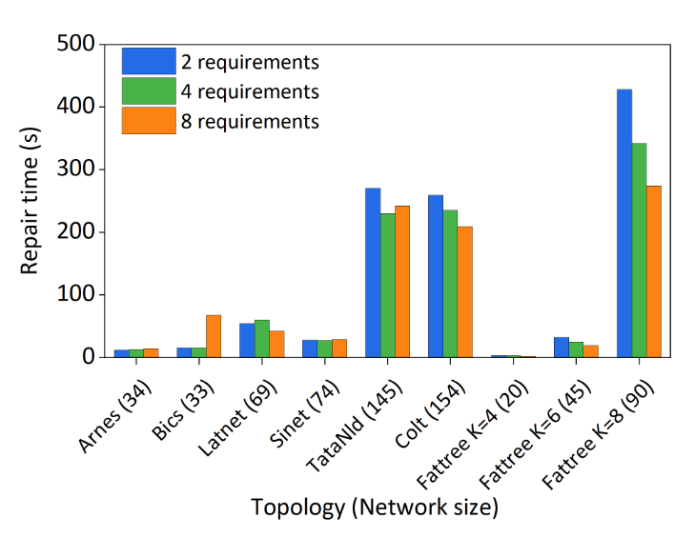
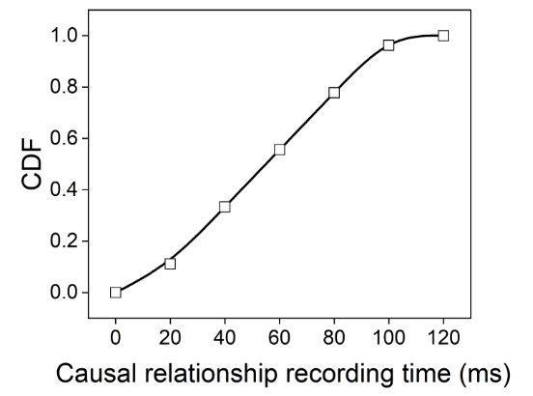
Scalpel: evaluation
Record causal relationships
< 0.1s in 90% experiments
Repair time
O(10s)~O(100s)

Slide 26
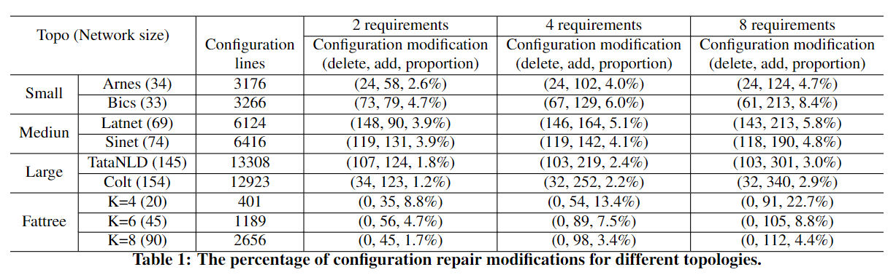
Scalpel: evaluation
Configuration modification ratio
<10% in most tests

Slide 27

Conclusion
For more information about Scalpel,
please contact (qiaoxiang@xmu.edu.cn)
Automating network configuration management
helps build reliable networks for data analytics
Existing tools can not directly apply to traditional networks
Key insight of Scalpel: Transfer distributed route computations into linear execution trace to enable efficient configuration error diagnosis and repair
Design of Scalpel: CRG capture, sound and minimal configuration error localization algorithm, configuration repairer using constraint solver
Prototype: Batfish plug-in to be open-sourced
Preliminary evaluation: fast, accurate with a low overhead

Slide 28
Vision: automating network configuration management cross domains
Control plane verification
A-Graph [INFOCOM'21]
CCoral [WIP]
Network Verification
Inter-
domain configuration management
Inter-domain synthesis
SDI [INFOCOM'20]
Data plane verification
Coral [HotNets'22]
Flash [SIGCOMM'22]
Inter-domain verification
IVeri [arXiv'21]
ICoral [WIP]
IVeriNG [WIP]
Configuration Repair
Error Diagnosis
Inter-domain repair
IRepair [WIP]
Configuration diagnosis and repair
Scalpel [WIP]

Slide 29






XMU System and Networking Group
Welcome to Xiamen!
Young group
4 PhD students
14 graduate students
7 undergraduate students
Fun research projects
Networking and formal method
Programmable network
High-performance network
Interpretable intelligent network

